Slide 1
AGENDA: Introduction to DevOps, Need, its Perspective, Agile and team structure.
TEACHNING OUTCOME/OBJECTIVE: 1.1
1.2
1.3
1.4
1.5

Slide 2
DevOps
A Software Architect's Perspective

Slide 3
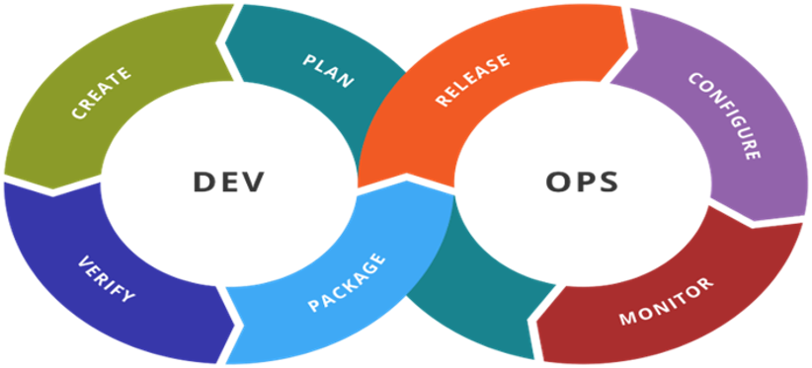
What is DevOps
DevOps is a set of practices intended to reduce the time between committing a change to a system and the change being placed into normal production, while ensuring high quality.

Slide 4
DevOps Implications
The quality of the deployed change to a system
High quality delivery mechanism
Identify two time periods
One is the time when a developer commits newly developed code. This marks the end of basic development and the beginning of the deployment path.
The second time is the deploying of that code into production
Define your goal; reduce the time between a commit from a developer and deploying into production
Finally, do not restrict the scope of DevOps practices to testing and deployment

Slide 5
DevOps Practices
Treat Ops as first-class citizens from the point of view of requirements. Have Operations teams set requirements that pertain to logging and monitoring
Make Dev more responsible for relevant incident handling. These practices are intended to shorten the time between the observation of an error and the repair of that error
Enforce the deployment process used by all, including Dev and Ops personnel and reduce errors
Use CI/ CD (continuous integration/ continuous deployment)
Develop infrastructure code, such as deployment scripts, with the same set of practices as application code

Slide 6
DevOps Example
IMVU, Inc. is a social entertainment company whose product allows users to connect through 3D avatar-based experiences. This section is adapted from a blog written by an IMVU engineer.
IMVU does continuous integration. The developers commit early and often. A commit triggers an execution of a test suite. IMVU has a thousand test files, distributed across 30–40 machines, and the test suite takes about nine minutes to run. Once a commit has passed all of its tests, it is automatically sent to deployment. This takes about six minutes. The code is moved to the hundreds of machines in the cluster, but at first the code is only made live on a small number of machines (canaries). A sampling program examines the results of the canaries and if there has been a statistically significant regression, then the revision is automatically rolled back. Otherwise the remainder of the cluster is made active. IMVU deploys new code 50 times a day, on average.

Slide 7
Why DevOps
DevOps, in many ways, is a response to the problem of slow releases. The longer it takes a release to get to market, the less advantage will accrue from whatever features or quality improvements led to the release.
Ideally, we want tore lease in a continuous manner.

Slide 8
Why DevOps
Reduced deployment failures and rollbacks
The shorter development cycles with DevOps promote more frequent code releases.
Improved communication and collaboration
The culture becomes focused on performance rather than individual goals. When the teams trust each other, they can experiment and innovate more effectively
Reduced costs and headcount
Increased efficiencies through automation

Slide 9
Increased Efficiencies
Increased efficiency helps to speed the development process and make it less prone to error. There are ways to automate DevOps tasks. Continuous integration servers automate the process of testing code, reducing the amount of manual work required. This means that software engineers can focus on completing tasks that can’t be automated.
Acceleration tools are another opportunity for increasing efficiency. For example:
Scalable infrastructures, such as cloud-based platforms, increase the access the team has to hardware resources. As a result, testing and deployment operations speed up.
Build acceleration tools can be used to compile code more quickly.
Parallel workflows can be embedded into the continuous delivery chain to avoid delays; one team waits for another to complete its work.
Using one environment avoids the useless task of transferring data between environments. This means you don’t have to use one environment for development, a different environment for testing, and a third for deployment.

Slide 10
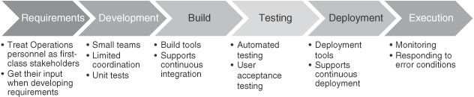
DevOps Perspective
DevOps comes in multiple flavors and with different degrees of variation from current practice, but two themes run consistently through the different flavors: automation and the responsibilities of the development team.

Slide 11
DevOps Perspective
Automation
The steps from build and testing through execution can all be automated to some degree
Tools can perform the actions required in each step of the process, check the validity of actions against the production environment or against some external specification, inform appropriate personnel of errors occurring in the process, and maintain a history of actions for quality control, reporting, and auditing purposes.
Tools and scripts also can enforce organization-wide policies. Suppose the organization has a policy that every change has to have a rationale associated with the change. Then prior to committing a change, a tool or script can require a rationale to be provided by the individual making the change. Certainly, this requirement can be circumvented, but having the tool ask for a rationale will increase the compliance level for this policy.

Slide 12
DevOps Perspective
Development Team Responsibilities
Automation will reduce the incidence of errors and will shorten the time to deployment. To further shorten the time to deployment, consider the responsibilities of operations personnel as detailed earlier. If the development team accepts DevOps responsibilities, that is, it delivers, supports, and maintains the service, then there is less need to transfer knowledge to the operations and support staff since all of the necessary knowledge is resident in the development team. Not having to transfer knowledge removes a significant coordination step from the deployment process.

Slide 13
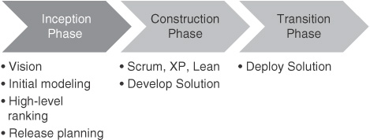
DevOps and Agile
One of the characterizations of DevOps emphasizes the relationship of DevOps practices to agile practices.
Disciplined Agile Delivery has three phases—inception, construction, and transition. In the DevOps context, we interpret transition as deployment.

Slide 14
Inception Phase
During the inception phase, release planning and initial requirements specification are done.
Considerations of Ops will add some requirements for the developers. Maintaining backward compatibility between releases and having features be software switchable are two of these requirements. The form and content of operational log messages impacts the ability of Ops to troubleshoot a problem.
Release planning includes feature prioritization but it also includes coordination with operations personnel about the scheduling of the release and determining what training the operations personnel require to support the new release. Release planning also includes ensuring compatibility with other packages in the environment and a recovery plan if the release fails. DevOps practices make incorporation of many of the coordination-related topics in release planning unnecessary, whereas other aspects become highly automated.

Slide 15
Construction Phase
During the construction phase, key elements of the DevOps practices are the management of the code branches, the use of continuous integration and continuous deployment, and incorporation of test cases for automated testing. These are also agile practices but form an important portion of the ability to automate the deployment pipeline. A new element is the integrated and automated connection between construction and transition activities.

Slide 16
Transition Phase
In the transition phase, the solution is deployed and the development team is responsible for the deployment, monitoring the process of the deployment, deciding whether to roll back and when, and monitoring the execution after deployment. The development team has a role of “reliability engineer,” who is responsible for monitoring and troubleshooting problems during deployment and subsequent execution.

Slide 17
Team Structure
In this section, the usual size of and roles within a development team with DevOps responsibilities are discussed.
Team Size
Although the exact team size recommendation differs from one methodology to another, all agree that the size of the team should be relatively small. Amazon has a “two pizza rule.” That is, no team should be larger than can be fed from two pizzas. Although there is a fair bit of ambiguity in this rule—how big the pizzas are, how hungry the members of the team are—the intent is clear.

Slide 18
Team Structure
Team Size
The advantages of small teams are:
They can make decisions quickly. In every meeting, attendees wish to express their opinions. The smaller the number of attendees at the meeting, the fewer the number of opinions expressed and the less time spent hearing differing opinions. Consequently, the opinions can be expressed and a consensus arrived at faster than with a large team.
It is easier to fashion a small number of people into a coherent unit than a large number. A coherent unit is one in which everyone understands and subscribes to a common set of goals for the team.
It is easier for individuals to express an opinion or idea in front of a small group than in front of a large one.

Slide 19
Team Structure
Team Size
The disadvantages of small teams are:
The disadvantage of a small team is that some tasks are larger than can be accomplished by a small number of individuals. In this case the task has to be broken up into smaller pieces, each given to a different team, and the different pieces need to work together sufficiently well to accomplish the larger task. To achieve this, the teams need to coordinate.

Slide 20
Team Structure
Team Roles
Team lead. This role, called “Scrum Master” in Scrum or team coach or project lead in other methods, is responsible for facilitating the team, obtaining resources for it, and protecting it from problems. This role encompasses the soft skills of project management but not the technical ones such as planning and scheduling, activities which are better left to the team as a whole.
Team member. This role, sometimes referred to as developer or programmer, is responsible for the creation and delivery of a system. This includes modeling, programming, testing, and release activities, as well as others.
Additional roles in a team executing a DevOps process consist of service owner, reliability engineer, gatekeeper, and DevOps engineer. An individual can perform multiple roles, and roles can be split among individuals. The assignment of roles to individuals depends on that individual’s skills and workload as well as the skills and amount of work required to satisfy the role.

Slide 21
Team Structure
Service Owner
The service owner is the role on the team responsible for outside coordination. The service owner participates in system-wide requirements activities, prioritizes work items for the team, and provides the team with information both from the clients of the team’s service and about services provided to the team. The requirements gathering and release planning activities for the next iteration can occur in parallel with the conception phase of the current iteration. Thus, although these activities require coordination and time, they will not slow down the time to delivery.
The service owner maintains and communicates the vision for the service. Since each service is relatively small, the vision involves knowledge of the clients of the team’s service and the services on which the team’s service depends. That is, the vision involves the architecture of the overall system and the team’s role in that architecture.
The ability to communicate both with other stakeholders and with other members of the team is a key requirement for the service owner.

Slide 22
Team Structure
Reliability Engineer
The reliability engineer has several responsibilities. First, the reliability engineer monitors the service in the time period immediately subsequent to the deployment. This may involve the use of canaries (live testing of a small number of nodes) and a wide variety of metrics taken from the service.
Second, the reliability engineer is the point of contact for problems with the service during its execution.
Once a problem occurs, the reliability engineer performs short-term analysis to diagnose, mitigate, and repair the problem, usually with the assistance of automated tools. This can occur under very stressful conditions (e.g., in the middle of the night). The problem may involve reliability engineers from other teams. In any case, the reliability engineer has to be excellent at troubleshooting and diagnosis.

Slide 23
Team Structure
Reliability Engineer
In addition to the short-term analysis, the reliability engineer should discover or work with the team to discover the root cause of a problem. The “5 Whys” is a technique to determine a root cause. Keep asking “Why?” until a process reason is discovered. For example, the deployed service is too slow and the immediate cause may be an unexpected spike in workload. The second “why” is what caused the unexpected spike, and so on. Ultimately, the response is that stress testing for the service did not include appropriate workload characterization. This process reason can be fixed by improving the workload characterization for the stress testing. Increasingly, reliability engineers need to be competent developers, as they need to write high-quality programs to automate the repetitive part of the diagnosis, mitigation, and repair.

Slide 24
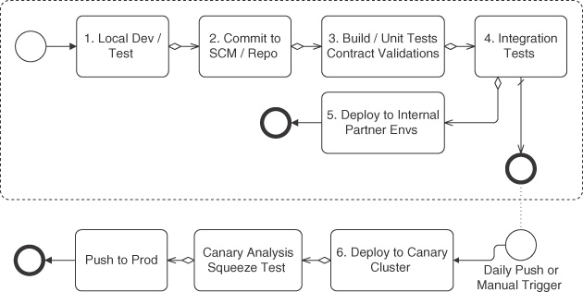
Team Structure
Gatekeeper
Netflix uses the steps given in image from local development to deployment.

Slide 25
Team Structure
Gatekeeper
Each arrow in this figure represents a decision to move to the next step.
This decision may be done automatically (in Netflix’s case) or manually. The manual role that decides to move a service to the next step in a deployment pipeline is a gatekeeper role. The gatekeeper decides whether to allow a version of a service or a portion of a service through “the gate” to the next step.
The gatekeeper may rely on comprehensive testing results and have a checklist to use to make this decision and may consult with others but, fundamentally, the responsibility for allowing code or a service to move on through the deployment pipeline belongs to the gatekeeper. In some cases, the original developer is the gatekeeper before deployment to production, making a decision informed by test results but carrying the full responsibility. Human gatekeepers (not the original developer) may be required by regulators in some industries such as the financial industry.

Slide 26
Team Structure
Gatekeeper
Mozilla has a role called a release coordinator (sometimes called release manager). This individual is designated to assume responsibility for coordinating the entire release. The release coordinator attends triage meetings where it is decided what is in and what is omitted from a release, understands the background context on all work included in a release, referees bug severity disputes, may approve late-breaking additions, and can make the back-out decision. In addition, on the actual release day, the release coordinator is the point for all communications between developers, QA, release engineering, website developers, PR, and marketing. The release coordinator is a gatekeeper.

Slide 27
Team Structure
DevOps Engineer
Some of the tools used are code testing tools, configuration management tools, continuous integration tools, deployment tools, or post-deployment testing tools.
Tools evolve, tools require specialized knowledge, and tools require specialized input. The DevOps engineer role is responsible for the care and feeding of the various tools used in the DevOps tool chain. This role can be filled at the individual level, the team level, or the organizational level. For example, the organization may decide on a particular configuration management tool that all should use.

Slide 28
Misc/ Appendix

Slide 29
DevOps Practices
Develop infrastructure code, such as deployment scripts, with the same set of practices as application code.
Practices that apply to the development of infrastructure code are intended to ensure both high quality in the deployed applications and that deployments proceed as planned. Errors in deployment scripts such as misconfigurations can cause errors in the application, the environment, or the deployment process. Applying quality control practices used in normal software development when developing operations scripts and processes will help control the quality of these specifications.
Make Dev more responsible for relevant incident handling
These practices are intended to shorten the time between the observation of an error and the repair of that error. Organizations that utilize these practices typically have a period of time in which Dev has primary responsibility for a new deployment; later on, Ops has primary responsibility.

Slide 30
DevOps Practices
Enforce the deployment process used by all, including Dev and Ops personnel.
These practices are intended to ensure a higher quality of deployments. This avoids errors caused by ad hoc deployments and the resulting misconfiguration. The practices also refer to the time that it takes to diagnose and repair an error. The normal deployment process should make it easy to trace the history of a particular deployment artifact and understand the components that were included in that artifact.
Use continuous deployment.
Practices associated with continuous deployment are intended to shorten the time between a developer committing code to a repository and the code being deployed. Continuous deployment also emphasizes automated tests to increase the quality of code making its way into production.

